Slide 1
Lab 5: LLVM Pass
Software Testing 2021
2022/03/31
tl455047

Slide 2
This lab will cover
a little bit compiler concept
llvm pass
some assembly concept
some C++ OOP concept

Slide 3
LLVM

Slide 4

Three-Phase Compiler
Frontend, Optimizer, Backend
解析、優化、輸出
source code -> IR -> machine code

Slide 5
Why LLVM?
Analysis
control flow graph
Instrumentation
sanitizer

Slide 6
LLVM Pass
Notes:
difference between LLVM & LLVM Pass?

Slide 7
Caution!
All following content works on llvm-11, other versions are not guaranteed!
All API can be found in https://llvm.org/doxygen/index.html
Notes:
“The” following content

Slide 8
Pass
clang - llvm
source code
Frontend
Midend
Backend
machine code
Pass
Pass
Pass
Pass
Pass

Slide 9
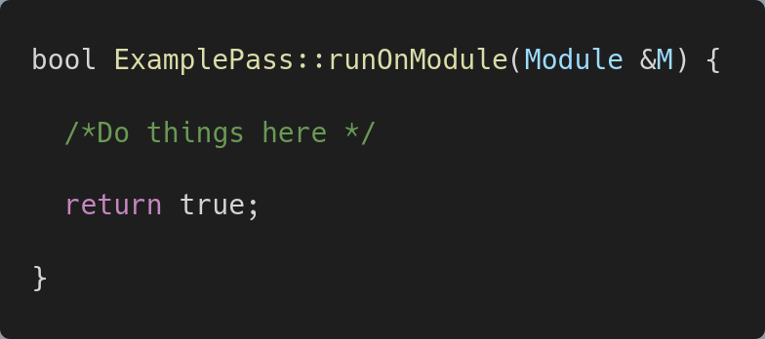
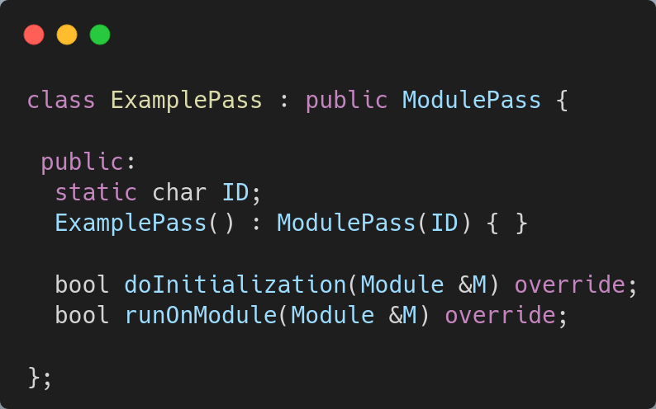
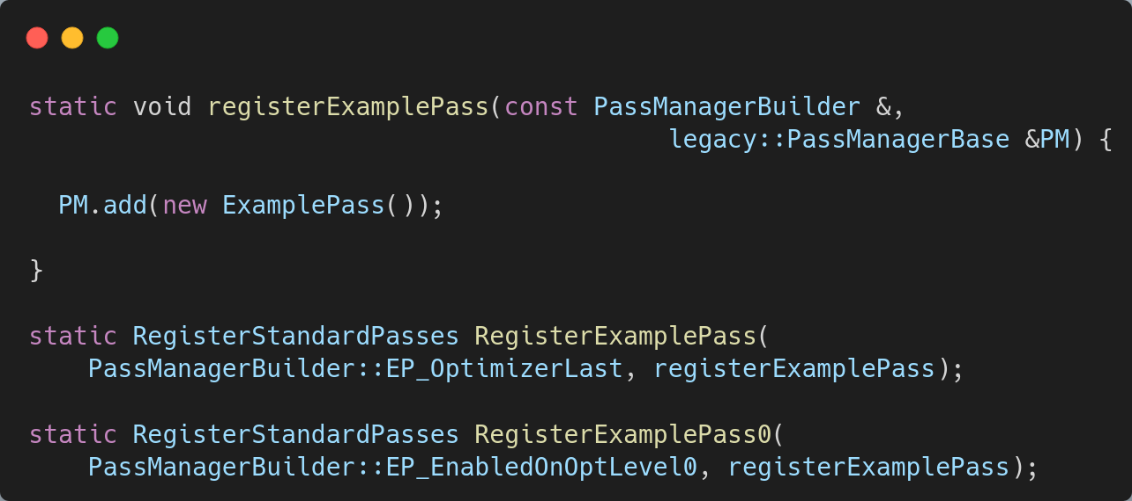
Pass
inherit from Pass class
ModulePass
FunctionPass
…

Slide 10
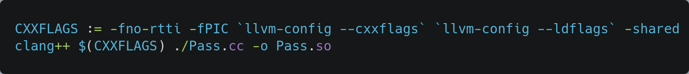
Pass
Pass.cc
Pass.so

Slide 11
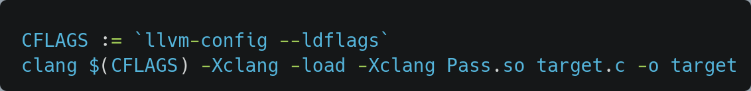
Pass
clang - llvm
target.c
Frontend
Midend
Backend
target
Pass
Pass
Pass
Pass
Pass.so

Slide 12
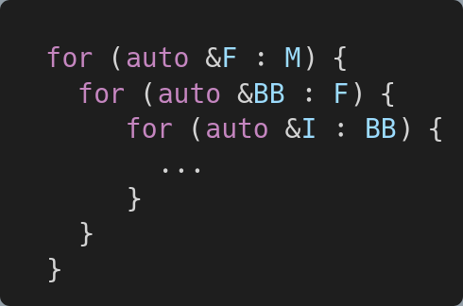
LLVM Structure
Module
Function
BasicBlock
Instruction (IR)
https://llvm.org/docs/LangRef.html

Slide 13
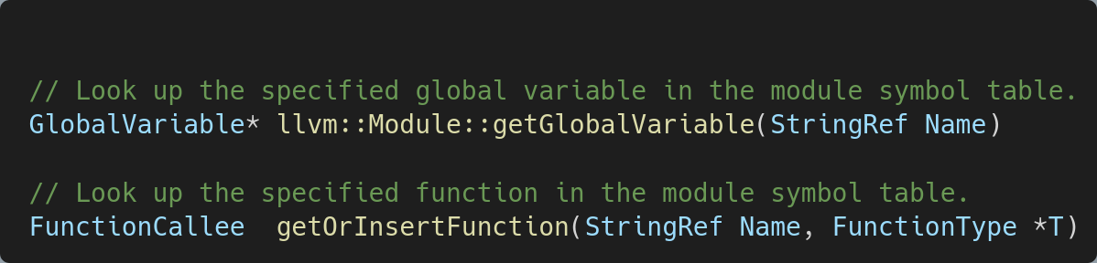
LLVM Structure
Module
top-level structure in an LLVM program
https://llvm.org/doxygen/classllvm_1_1Module.html
Notes:
稍微講解一下 symbol table / IR / AST 有些同學可能沒修過 compiler AST - https://vinaytech.files.wordpress.com/2008/10/img21.png Symbol Table - https://media.springernature.com/original/springer-static/image/chp%3A10.1007%2F978-981-10-3153-3_36/MediaObjects/421448_1_En_36_Fig3_HTML.gif

Slide 14
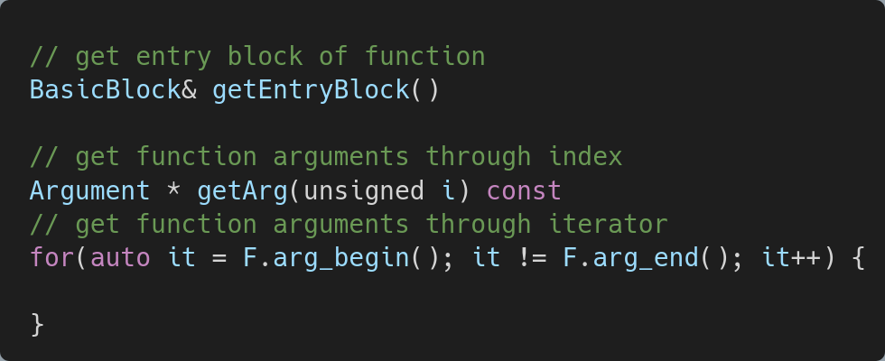
LLVM Structure
Function
https://llvm.org/doxygen/classllvm_1_1Function.html

Slide 15
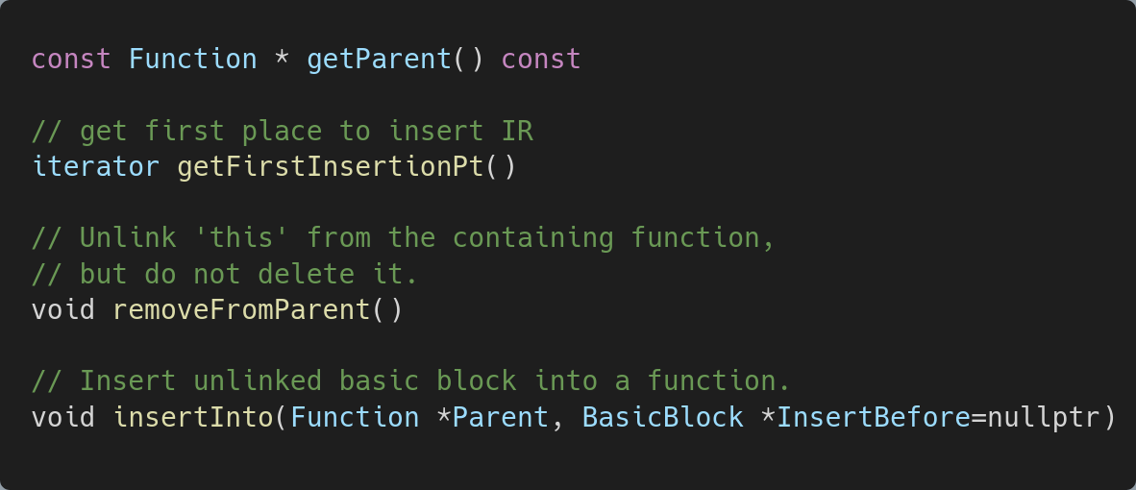
LLVM Structure
BasicBlock
https://llvm.org/doxygen/classllvm_1_1BasicBlock.html

Slide 16
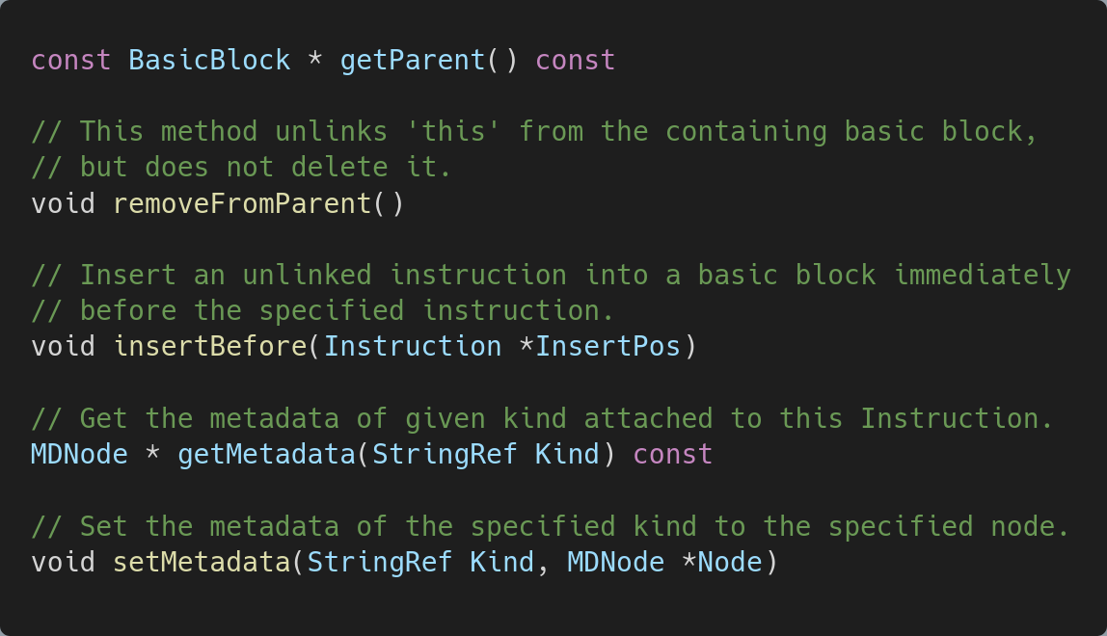
LLVM Structure
Instruction (IR)
https://llvm.org/doxygen/classllvm_1_1Instruction.html

Slide 17
Value
llvm::Function
llvm::GlobalObject
llvm::Argument
llvm::GlobalValue
llvm::GlobalVariable
llvm::BasicBlock
llvm::Value
llvm::Constant
llvm::User
llvm::Instruction

Slide 18
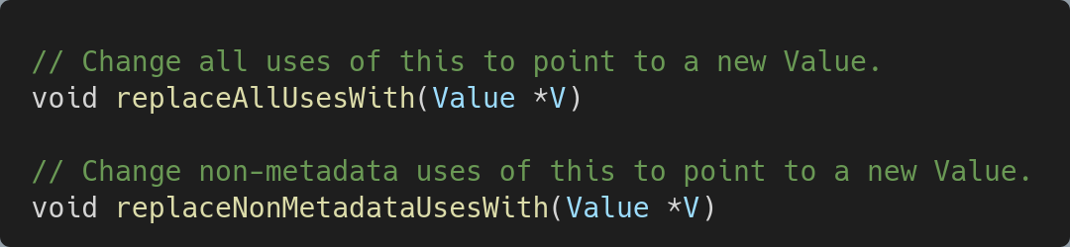
Value
https://llvm.org/doxygen/classllvm_1_1Value.html

Slide 19
Type
llvm::ArrayType
llvm::FunctionType
llvm::Type
llvm::IntegerType
llvm::PointerType
https://llvm.org/doxygen/classllvm_1_1Type.html

Slide 20
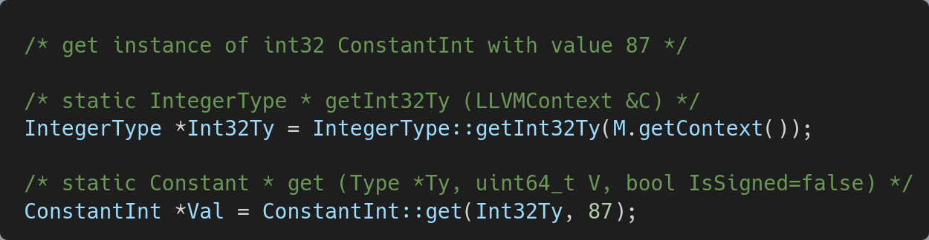
ConstantInt
get instance of int32 ConstantInt
https://llvm.org/doxygen/classllvm_1_1ConstantInt.html

Slide 21
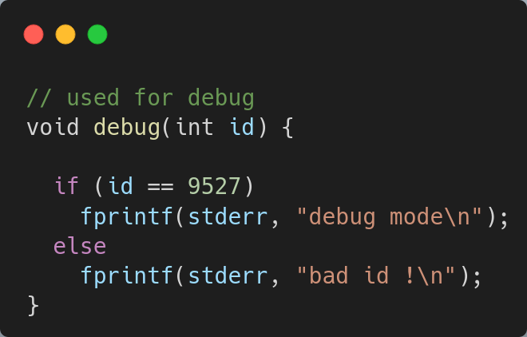
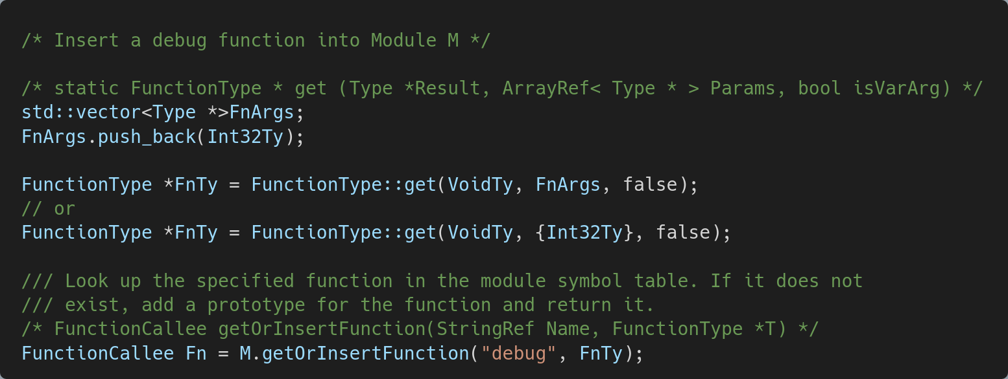
getOrInsertFunction
https://llvm.org/doxygen/classllvm_1_1Module.html

Slide 22
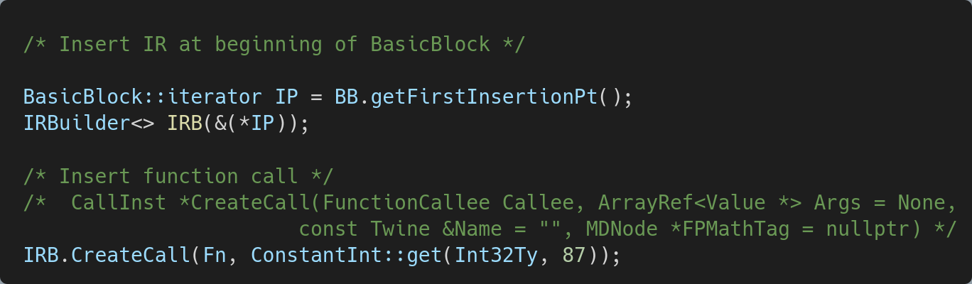
IRBuilder
insert new IR at specific position
https://llvm.org/doxygen/classllvm_1_1IRBuilderBase.html

Slide 23
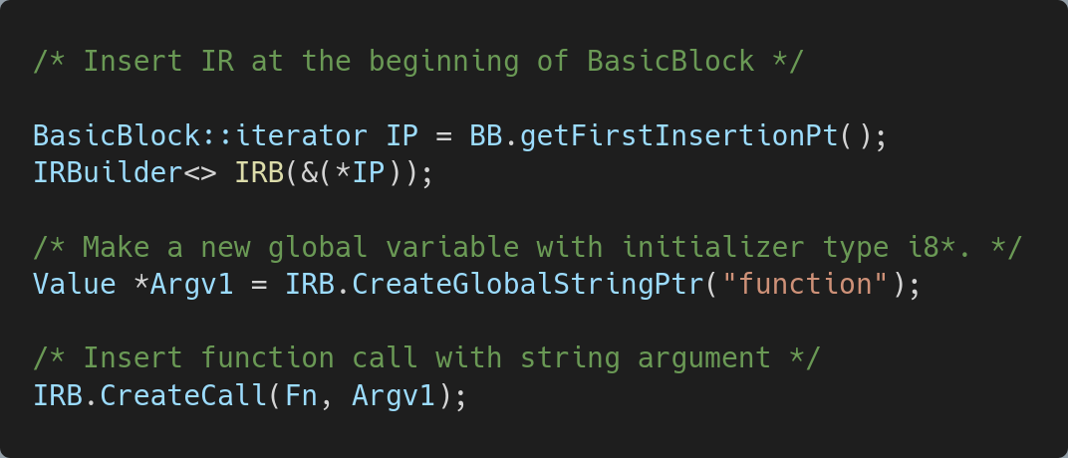
IRBuilder
insert new IR at specific position
https://llvm.org/doxygen/classllvm_1_1IRBuilderBase.html

Slide 24
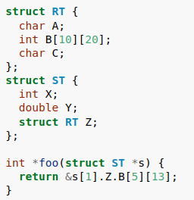
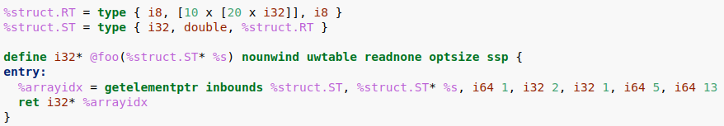
LLVM IR
getelementptr Instruction
used to get the address of a subelement of an aggregate data structure.
https://llvm.org/docs/LangRef.html
Notes:
to get … or it is used to get …

Slide 25
Example 1: AFL LLVM Pass
https://github.com/google/AFL/blob/master/llvm_mode/afl-llvm-pass.so.cc

Slide 26
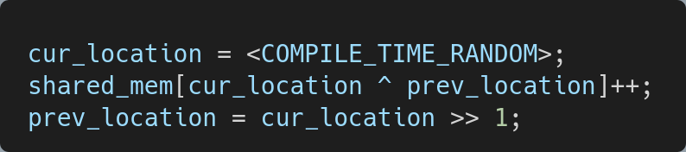
Coverage Instrumentation
Instrument following code into each BasicBlock
Notes:
“the” following code

Slide 27
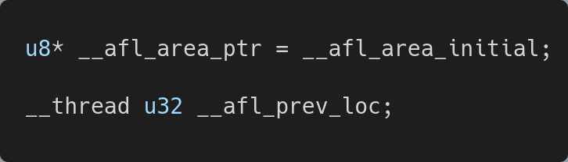
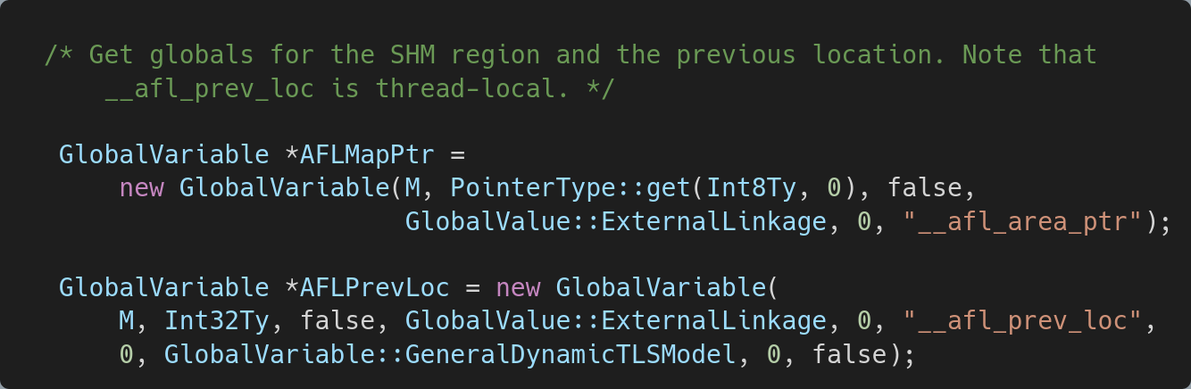
Coverage Instrumentation
Get Global Variable shared_mem, prev_loc
In afl-llvm-rt.o.c
Pass.cc

Slide 28
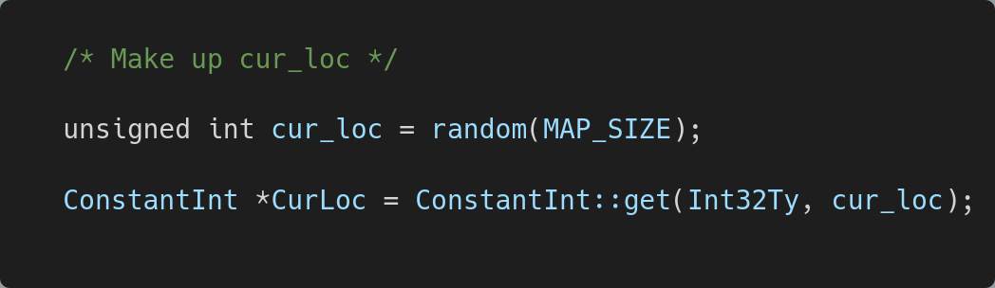
Coverage Instrumentation
Make up cur_loc
Pass.cc

Slide 29
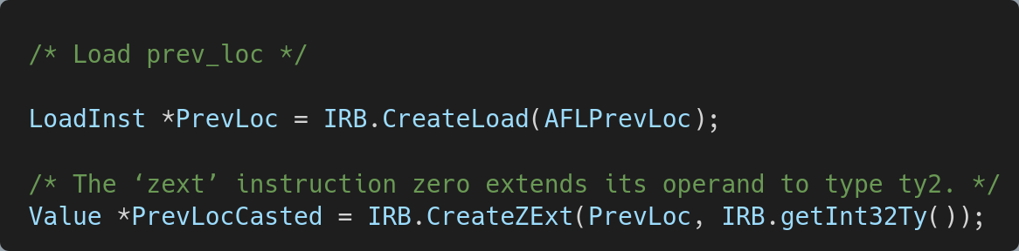
Coverage Instrumentation
Load prev_loc
In LLVM, to access global variable value or pointer value, we need to use LoadInst
Pass.cc
Notes:
In LLVM, we use LoadInst to access global var or pointer val

Slide 30
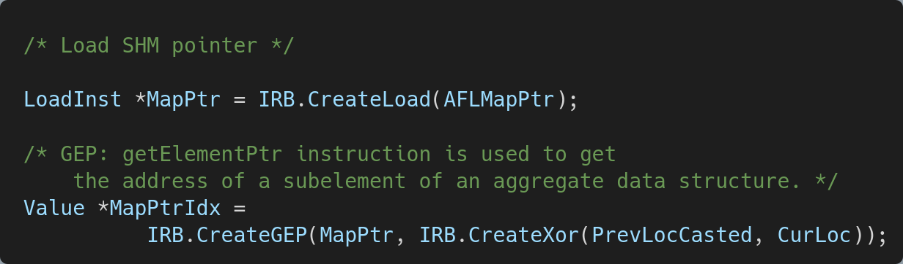
Coverage Instrumentation
Load SHM pointer
In LLVM, getElementPtr only calculates address, it does not access memory
Pass.cc

Slide 31
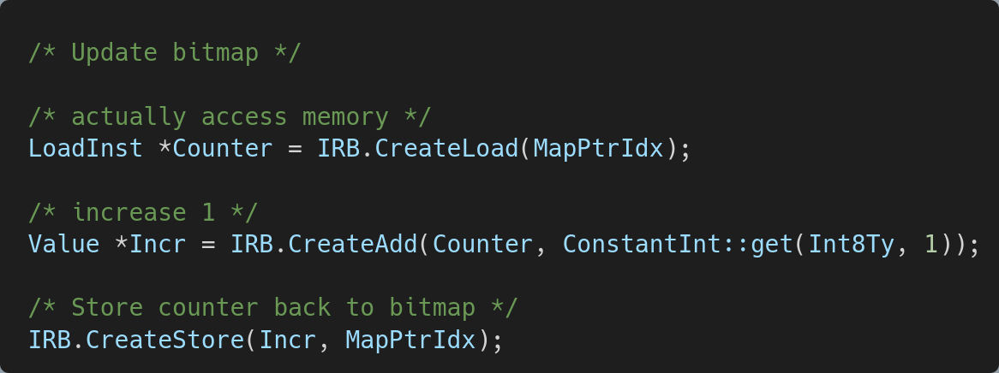
Coverage Instrumentation
Update bitmap
Pass.cc

Slide 32
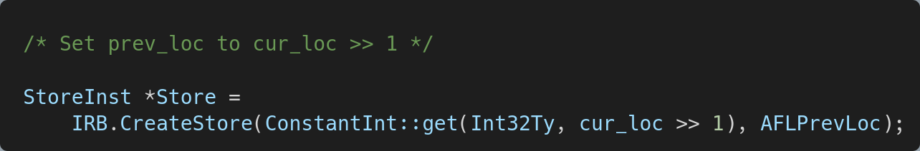
Coverage Instrumentation
Set prev_loc to cur_loc >> 1
Pass.cc

Slide 33
Lab

Slide 34
Lab
Given a target.c file, write a llvm pass to satisfy following requirements without modifying source code.
Invoke debug function with the first argument is 9527 in main function. (40%)
Let argv[1] = "aesophor is ghost !!!" before checking. (30%)
Let argc = 9487 before checking. (30%)
Upgrade your llvm-lab-pass.cc to new e3.
We will compile your code and use it to instrument target.c.
We will execute ./target 1 and see the output result.
We may modify the output message after checking, so do not just instrument the output message.
We provide Pass.cc template, Makefile, and a docker file as testing environment.
Do not compress the files and plagiarism.
Notes:
“the” following

Slide 35
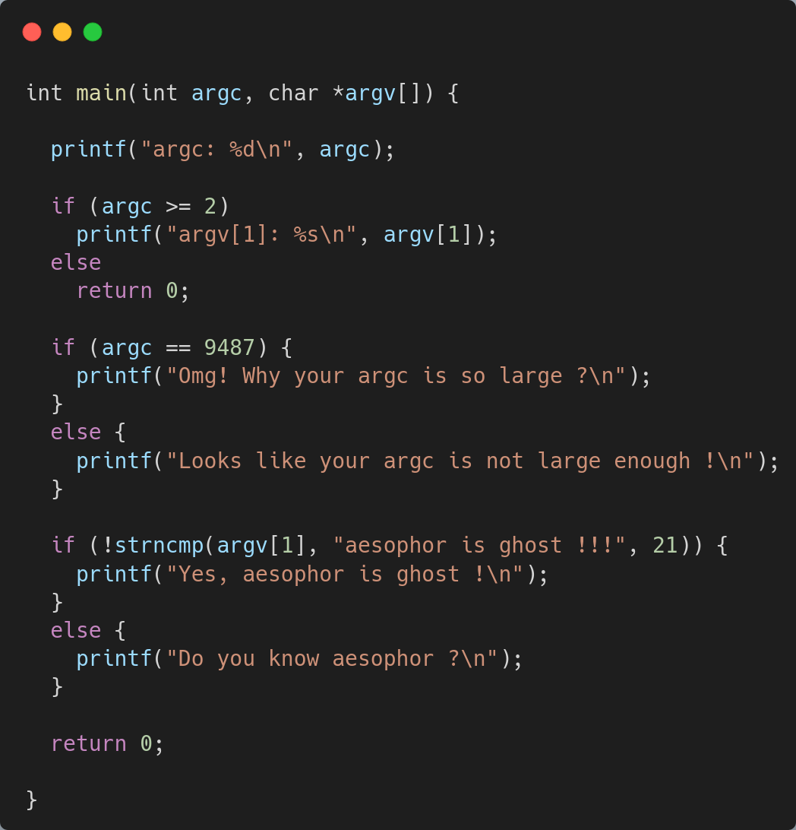
target.c

Slide 36
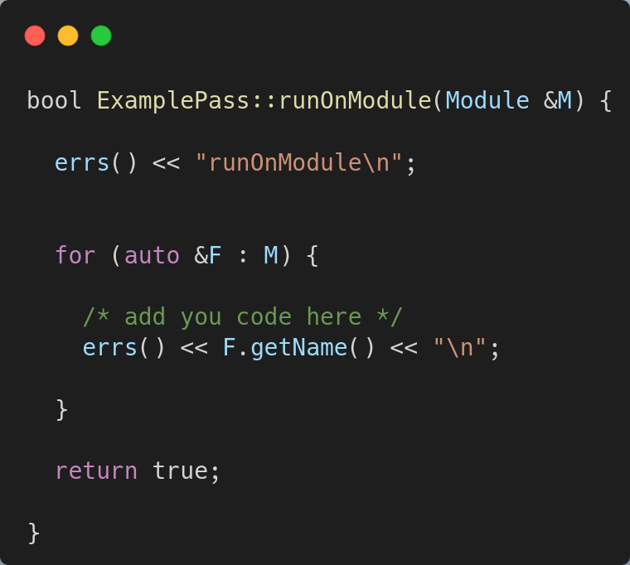
llvm-pass.cc

Slide 37
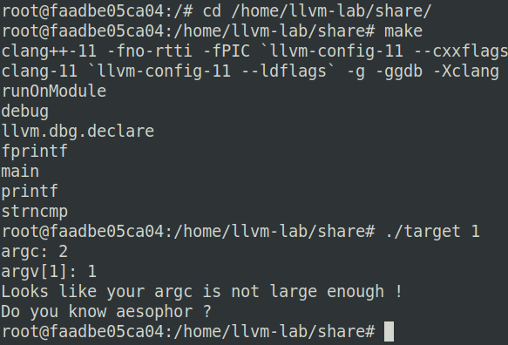
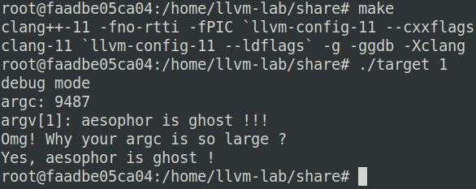
Demo
Original
Instrumentation

Slide 38
Environment
environment in docker file:
Download llvm-lab.zip from github
unzip and cd to distribute
sudo docker build -t llvm-lab . --no-cache
sudo docker run -v $PWD/share:/home/llvm-lab/share -it llvm-lab /bin/bash
cd /home/llvm-lab/share
make
./target 1

Slide 39
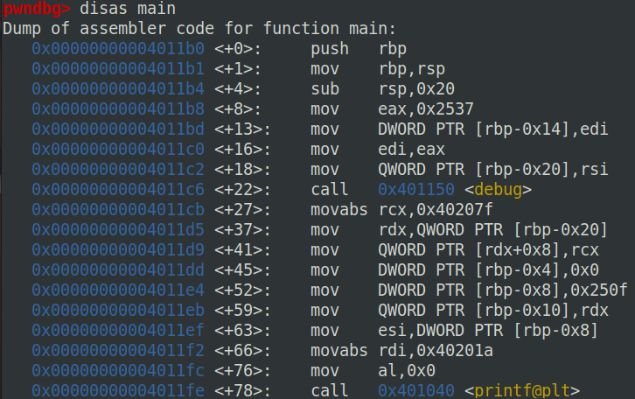
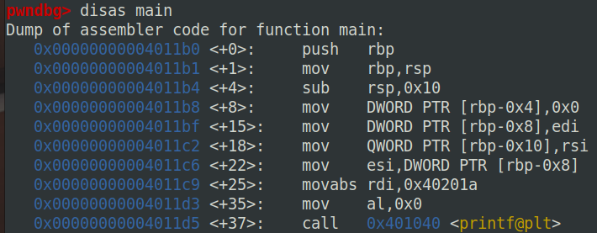
Debug
compile error
clang error message
Instrumentation debug
target output
gdb
Instrumentation
Original

Slide 40
Debug
call debug with arg1=9527=0x2537
x64 calling convention
arg1, arg2, arg3 will be set in rdi, rsi, rdx
Instrumentation
Original

Slide 41
Debug
let argc=9487=0x250f
Original
Instrumentation
ret
stack
rbp
arg1:argc
[rbp-0x8]
arg2
[rbp-0x10]
Instrumentation
ret
stack
rbp
arg1:9487
[rbp-0x8]
arg2
[rbp-0x10]

Slide 42

Debug
let argv[1]="aesophor is ghost !!!"
Original
Instrumentation
argv
argv[0]
argv[1]
“1”
Instrumentation
argv
[rdx]
[rdx+8]
string

Slide 43
Questions
tl455047.cs09@nycu.edu.tw

Slide 44
Reference
https://llvm.org/docs/LangRef.html
https://llvm.org/doxygen/index.html
https://github.com/google/AFL

